Slide 1

MODULE 3: PROGRAMMING FOR BIOLOGICAL DATA
Visualization & Reporting
ggtree and R Markdown
Instructor: Dr. Haogao Gu | Date: February 11, 2026

Slide 2

Welcome to the Final Session! 🎉
Journey So Far
•
Sessions 1-4: R Fundamentals
•
Sessions 5-8: Statistics & Quality Control
•
Sessions 9-11: Bioinformatics (Sequences, Trees)
Today's Goal
Making your results look professional and reproducible.

Slide 3








Learning Objectives
ggtree
Metadata
Export
Reporting
Create publication-quality phylogenetic trees.
Annotate trees with clinical data (colors, shapes).
Save high-resolution figures (PNG, PDF).
Generate reproducible reports using R Markdown.

Slide 4

Part 1: Advanced Visualization with ggtree
Beyond Basic Plots

Slide 5
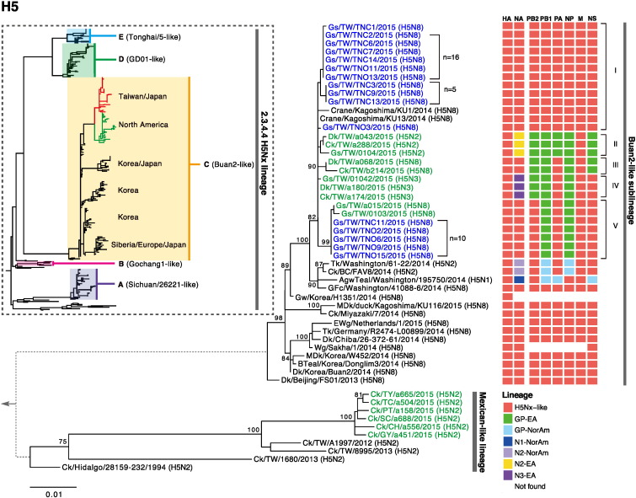

What is ggtree?
A Bioconductor package that extends ggplot2 specifically for phylogenetic trees.
•
Publication-ready aesthetics.
•
Layer-based syntax (grammar of graphics).
•
Supports multiple tree file formats.
•
Complex annotation capabilities.

Slide 6
ggtree vs. Base R (ape)
Feature | ape plot() | ggtree
Appearance | Basic, functional | Polished, customizable
Syntax | Base graphics | ggplot2 layers (+)
Metadata | Manual mapping | Easy integration (%<+%)
Learning Curve | Low | Medium (if new to ggplot)

Slide 7
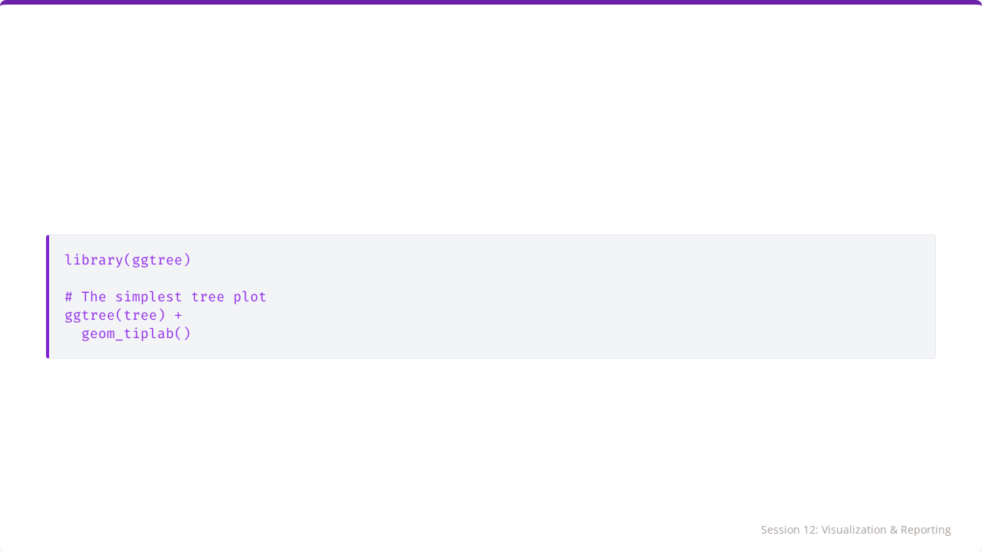
Basic ggtree Syntax
Just like ggplot(), we start with the base object and add layers.

Slide 8
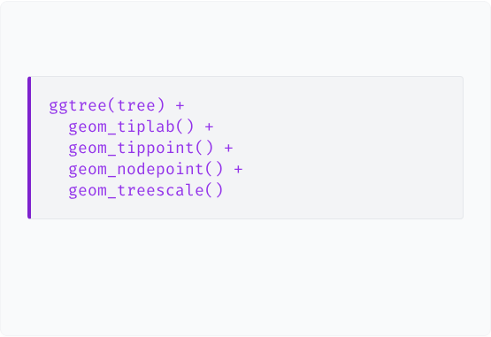

Adding Layers
Code
Explanation
•
geom_tiplab(): Adds text labels to tips.
•
geom_tippoint(): Adds dots to tips.
•
geom_nodepoint(): Adds dots to internal nodes.
•
geom_treescale(): Adds a distance scale bar.

Slide 9
Tree Layouts
# Rectangular (Standard) ggtree(tree, layout = "rectangular") # Circular (Good for large trees) ggtree(tree, layout = "circular") # Fan (Spreads out tips) ggtree(tree, layout = "fan")

Slide 10
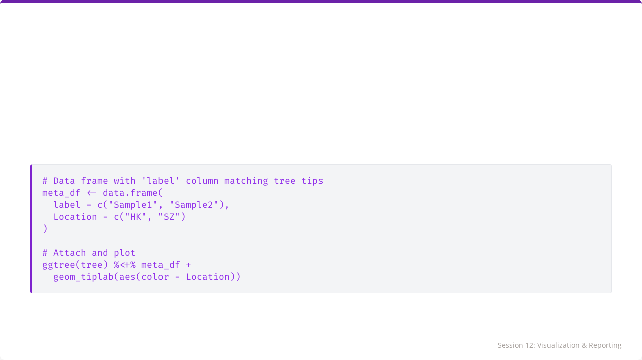
Attaching Metadata
The %<+% operator allows you to attach a data frame to the tree object.

Slide 11
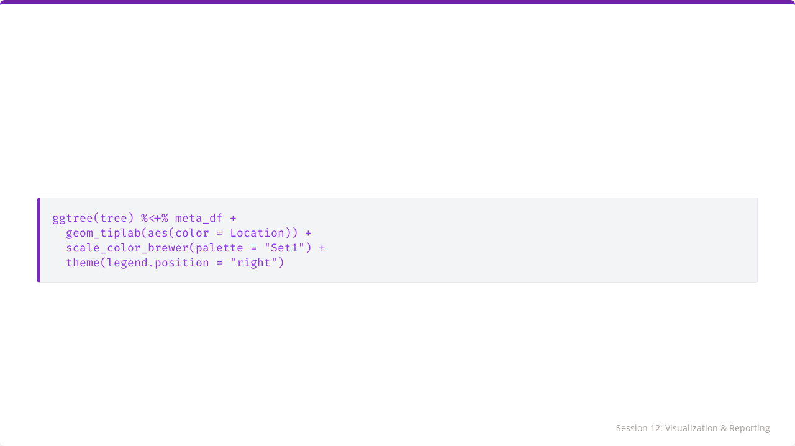
Coloring by Metadata
You can map colors, shapes, and sizes to any column in your attached metadata.

Slide 12
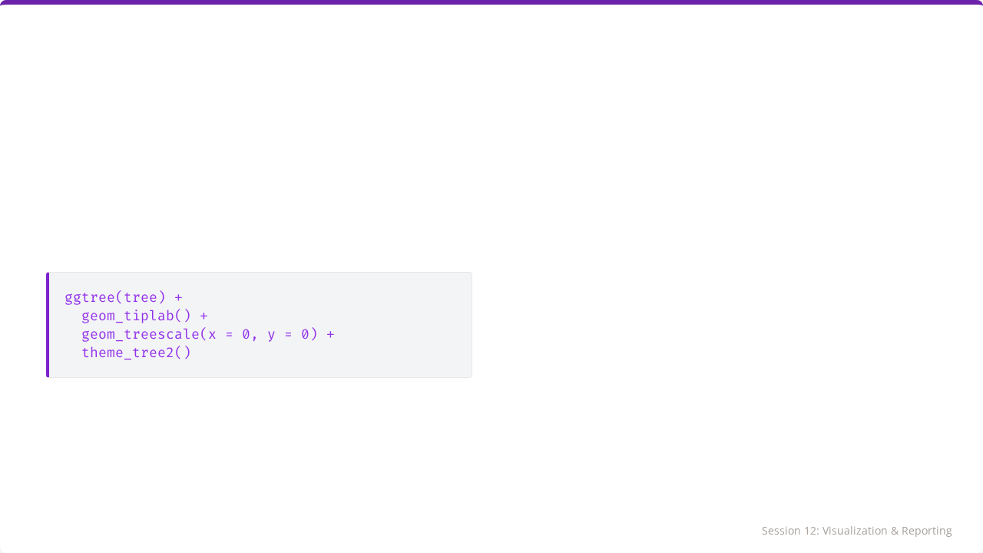
Adding a Scale Bar
geom_treescale() adds a traditional line scale.
theme_tree2() adds an axis with distance values at the bottom.

Slide 13
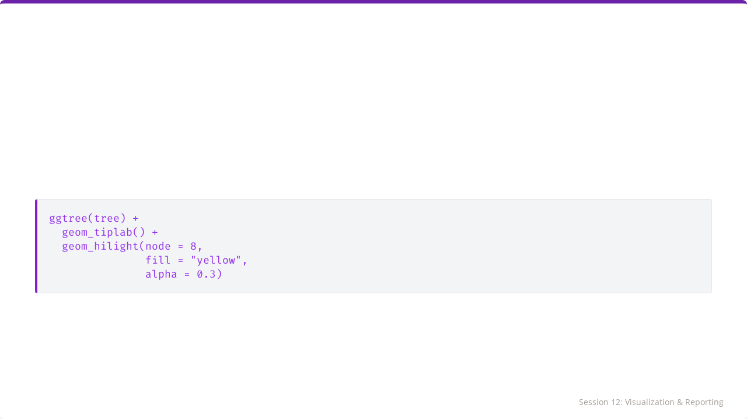
Highlighting Clades
Draw attention to specific clusters (e.g., an outbreak cluster).
You need to know the internal node ID to highlight a clade.

Slide 14
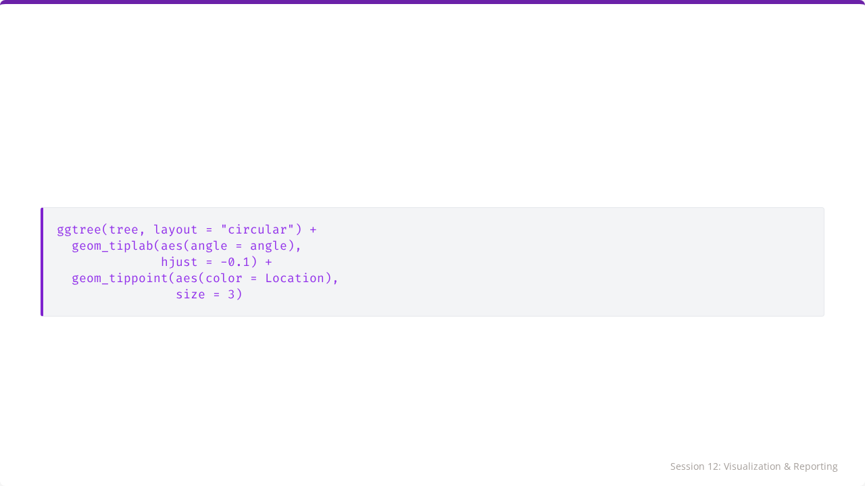
Circular Layout Example
Useful when you have >50 sequences, as it utilizes space more efficiently.

Slide 15
Saving High-Quality Figures
# Create plot object p <- ggtree(tree) + geom_tiplab() # Save as PNG (Raster) ggsave("tree.png", p, width = 8, height = 6, dpi = 300) # Save as PDF (Vector - Best for editing) ggsave("tree.pdf", p, width = 8, height = 6)

Slide 16
Publication Tips
Use theme_tree2() for axis clarity.
Set adequate fig.width and fig.height to prevent label overlap.
Use 300 dpi minimum for print.
Choose colorblind-friendly palettes (e.g., viridis).
Ensure text size is readable after resizing.

Slide 17

Part 2: R Markdown
Reproducible Research & Reporting

Slide 18
What is R Markdown?
A file format that combines:
1.
Code (R chunks).
2.
Results (Plots, Tables).
3.
Narrative (Text, explanations).
It "knits" these together into a final output document.

Slide 19


Why Use R Markdown?
Traditional Workflow
R Markdown Workflow
Run R -> Copy Graph -> Paste to Word -> Write Text.
Code and Text live together.
Solution: Data changes? Just click "Knit" and the report updates automatically.
Problem: Data changes? You have to redo everything manually.

Slide 20
Basic Structure
--- title: "My Report" output: html_document --- # Introduction This is the analysis of... {r} summary(data) # Conclusion The results show...

Slide 21
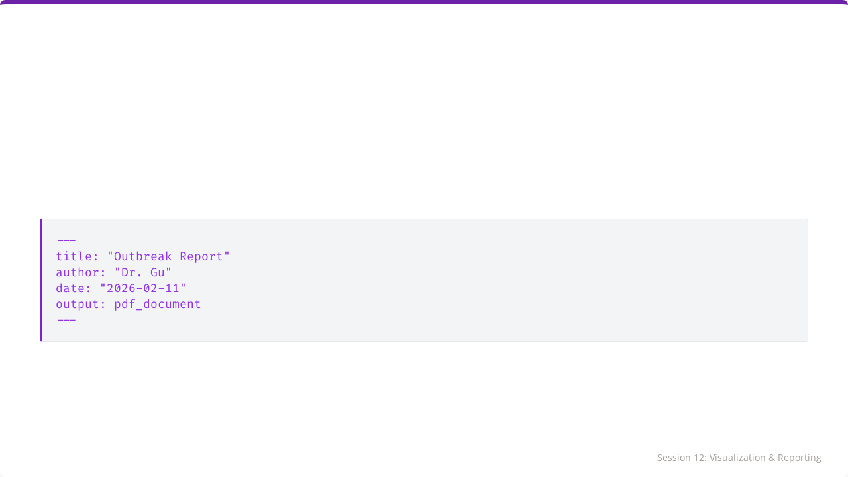
The YAML Header
Located at the very top of the file, between --- lines.
Controls the document metadata and output format (PDF, HTML, Word).

Slide 22
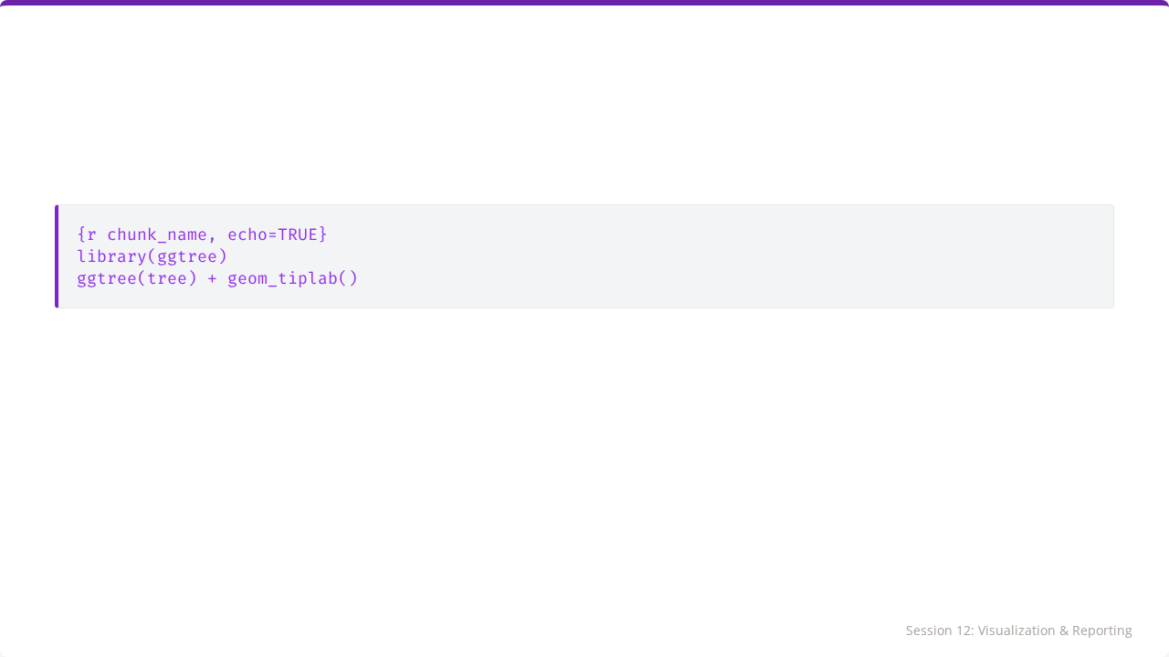
Code Chunks
Code goes inside the triple backticks.
Chunk Options: Control behavior.
•
echo=TRUE: Show code in report.
•
eval=TRUE: Run code.
•
fig.width=8: Figure width.

Slide 23
Common Chunk Options
Option | Effect | Use Case
echo=FALSE | Hide code, show output | Reports for non-coders (clinicians/managers)
eval=FALSE | Show code, don't run | Teaching/Demonstration
warning=FALSE | Suppress warnings | Cleaner final document
message=FALSE | Suppress messages | Hide "Loading package" text

Slide 24


Inline R Code
You can embed R results directly into sentences.
Output:

Slide 25



Applications in Clinical Labs
QC Reports
Outbreak Summaries
Audit Trails
Automated monthly LJ chart summaries.
Rapid generation of phylogenetic trees + case counts.
Code documents exactly how data was processed.

Slide 26
Complete Report Example
# Outbreak Investigation ## Methods Sequences aligned with ClustalW. NJ tree built with ape. ## Results Figure 1 shows the phylogenetic relationships. {r, echo=FALSE, fig.cap="Outbreak Tree"} ggtree(tree) + geom_tiplab() ## Conclusion Patient X belongs to the Omicron cluster.

Slide 27
Key Takeaways
•
ggtree provides the power to create professional, annotated trees.
•
Metadata integration is seamless with %<+%.
•
Exporting at 300dpi is essential for publication.
•
R Markdown enables reproducible, automated reporting.
•
These tools transform raw data into communicable knowledge.

Slide 28

🎓 Course Complete!
You are now R-Ready.
From Variables to Visualizations.

Slide 29

Tutorial 12
The Final Outbreak Report
Open your R environment

Slide 30
Tutorial 12: The Final Outbreak Report
Publication-Quality Phylogenetic Visualization

Slide 31
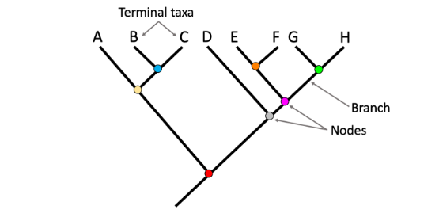
Your Scenario
The Task
Create a publication-quality figure for your outbreak investigation.
Requirements:
•
Use ggtree.
•
Color tips by location.
•
Add a scale bar.
•
Export as high-res PNG.

Slide 32
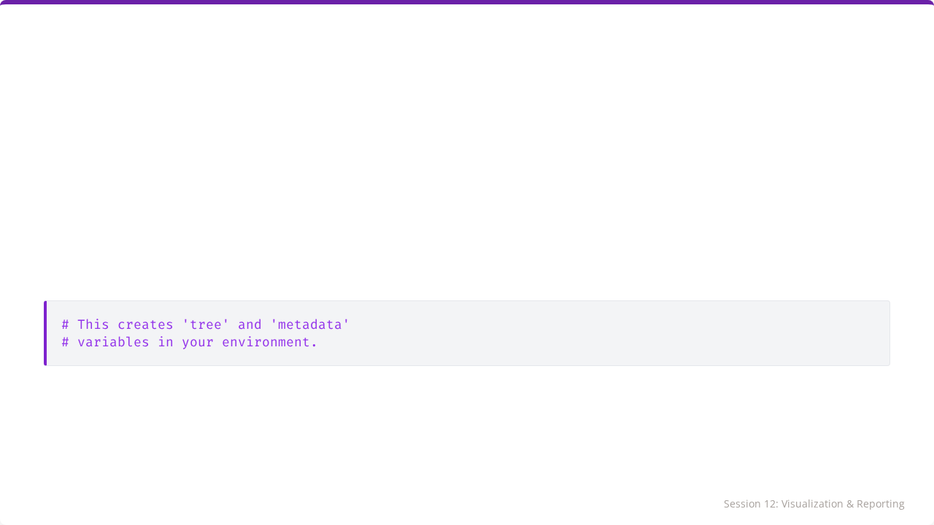
Step 1: Load Data
Run the provided code to generate the tree and metadata objects.

Slide 33
Step 2: Basic ggtree
# Create basic plot ggtree(tree) + geom_tiplab()

Slide 34
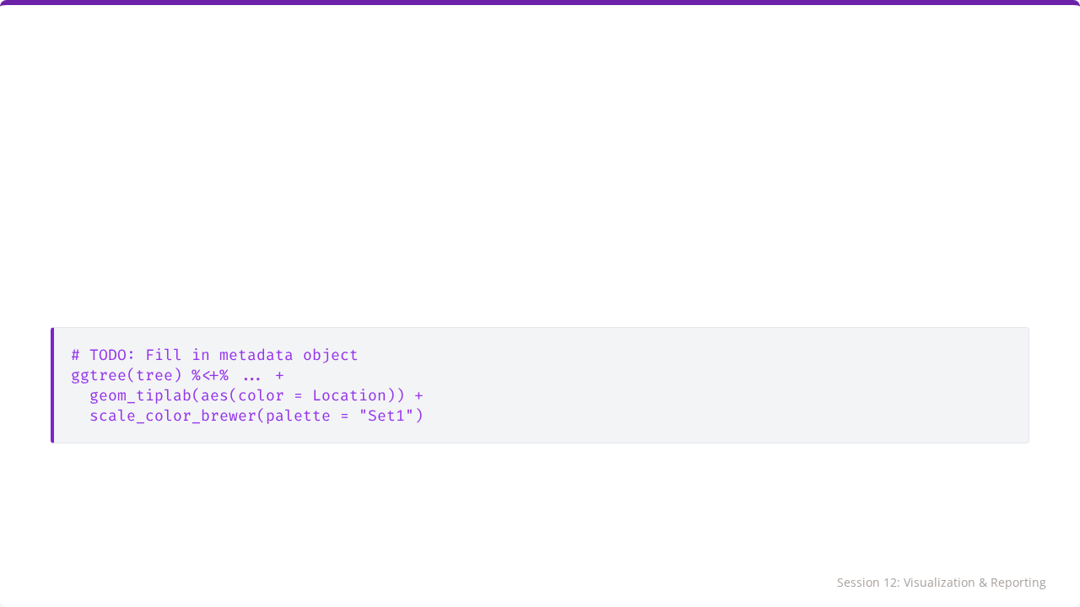
Step 3: Add Metadata
Attach the metadata and color by Location.

Slide 35
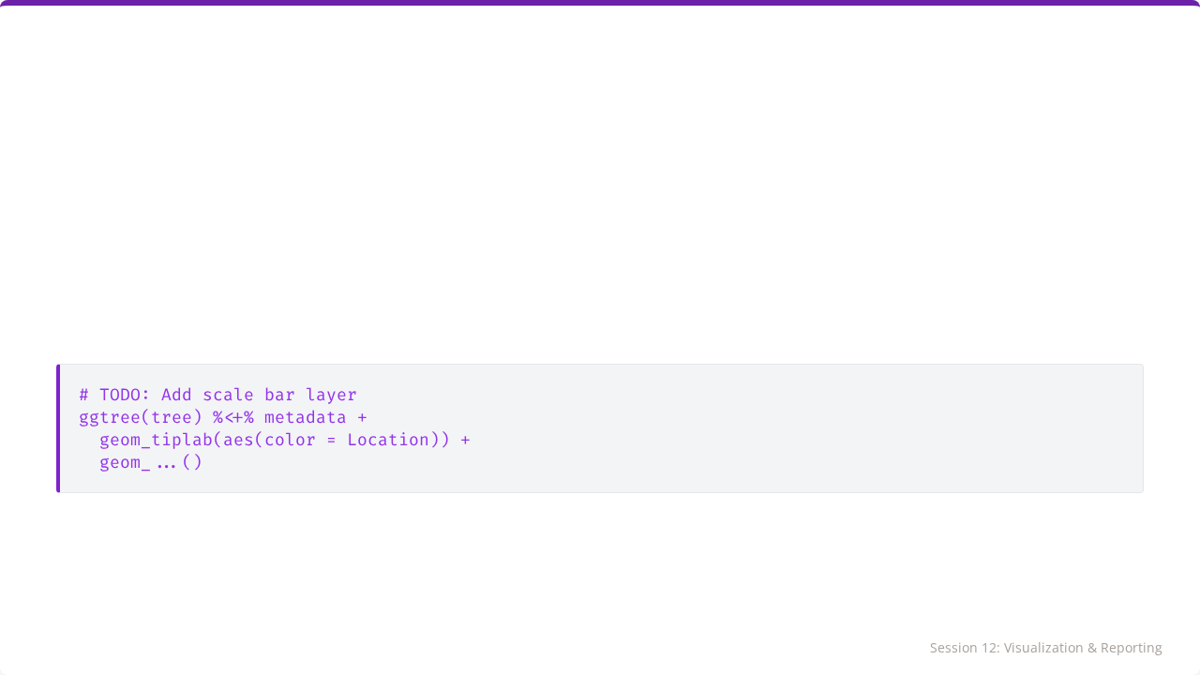
Step 4: Refine & Scale
Add a scale bar and adjust formatting.

Slide 36
Step 5: Export
final_plot <- ... # Your plot code ggsave("outbreak_phylogeny.png", final_plot, width = 10, height = 6, dpi = 300)

Slide 37

Tutorial Complete
Proceed to Assessment 4.

Slide 38

Image Sources
https://www.digitalatlasofancientlife.org/wp-content/uploads/2019/10/PartsOfPhylogeneticTree.png
Source: www.digitalatlasofancientlife.org

